Slide 1
A Focus on GICS Sector - Real Estate
Analyzing Financial Performance of Real Estate Companies (2013-2015) Using NYSE Data from Kaggle

Slide 2

Introduction
The real estate sector, a pivotal component of the economy, plays a vital role in shaping financial landscapes. This analysis delves into the financial evolution of real estate companies over the period 2013-2015
Research Question
My focus is on understanding how the total revenue and operating expenses of real estate companies evolved during the Three-year span (2013-2015), providing insights into the sector's overall financial performance.

Slide 3
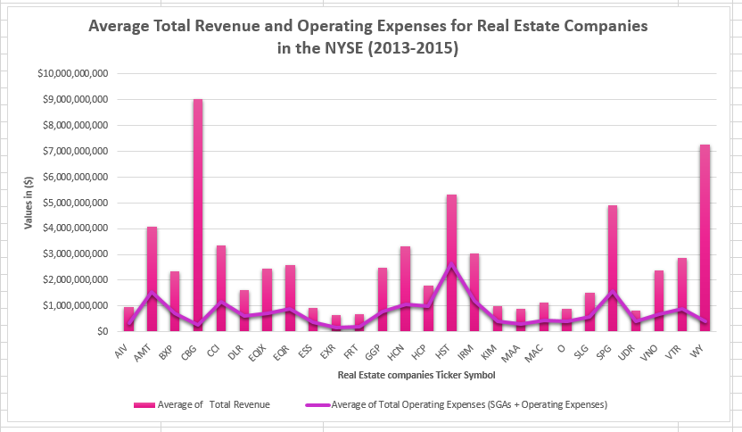
How Did the Consolidated Average Total Revenue and Operating Expenses Shape the Financial Landscape of Real Estate Companies from 2013 to 2015?
CBG excels with the highest average revenue ($9,030,174,000) and efficient cost management, showcasing robust financial performance.
WY follows closely, demonstrating a strategic balance with substantial revenue ($7,246,333,333) and controlled operating expenses ($415,666,667).
EXR focuses on profitability through low expenses ($186,397,667) despite having the lowest average revenue ($650,012,667) among real estate companies.
HST invests substantially in operations, leading in operating expenses ($2,671,000,000), but questions arise about cost efficiency compared to CBG and WY.
Overall, the data underscores diverse financial strategies in the NYSE real estate market from 2013 to 2015, emphasizing the importance of balancing revenue generation and cost control for sustained success.

Slide 4
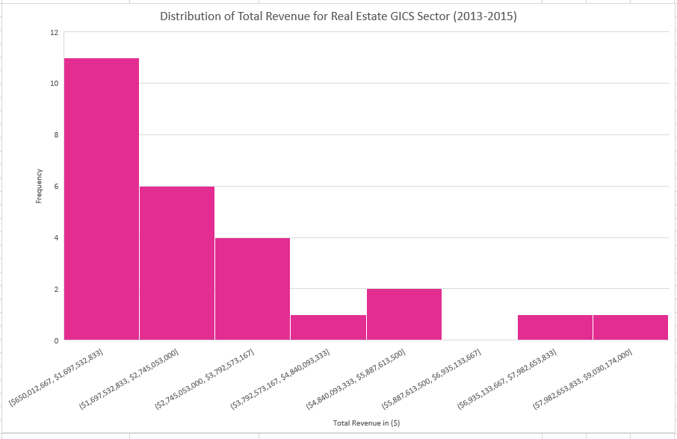
What Patterns Emerge in the Distribution of Average Total Revenue and Operating Expenses Across Real Estate Companies?
Distribution Overview:
Majority of companies (11) fall into the lower revenue range, forming the peak.
A right-skewed pattern indicates a concentration in the mid-to-lower revenue categories.
Few outliers (2) in higher revenue bins suggest potential industry leaders with significantly higher earnings.
Mid-Range Insights:
Moderate-sized groups in mid-range bins ($1.7B - $5.9B) indicate diversity in revenue levels.
Presence of a single company in the highest revenue bin ($7.9B - $9.0B) signifies an industry outlier.
Overall Implications:
Histogram provides a clear visualization of the distribution, aiding in identifying industry trends.
Outliers in higher revenue bins suggest a few companies significantly outperforming the majority.
Insights valuable for strategic planning, competition analysis, and industry positioning.

Slide 5
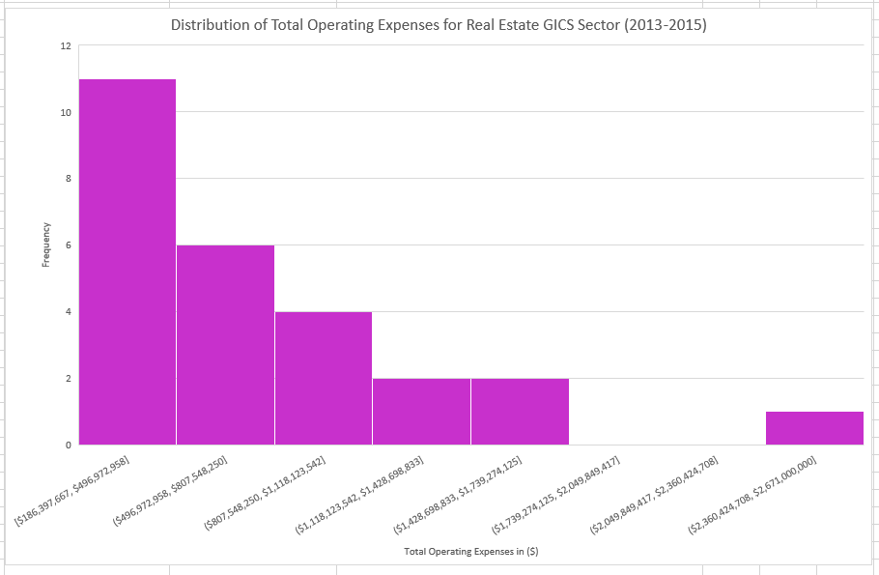
What Patterns Emerge in the Distribution of Average Total Revenue and Operating Expenses Across Real Estate Companies? (continued...)
Expense Profile:
Dominant group (11) with lower operating expenses suggests efficient cost management.
Right-skewed pattern indicates concentration in mid-to-lower operating expenses.
Presence of outliers in higher operating expenses bins (1) suggests companies with significant spending.
Mid and Higher Range Insights:
Varied groups in mid and higher range bins reflect diversity in operating expense levels.
Empty bins in mid-range indicate potential gaps or areas with less industry representation.
Strategic Considerations:
Histogram aids in understanding the distribution of operating expenses, crucial for financial planning.
Outliers in higher expense bins provide insights into companies facing unique challenges or pursuing aggressive growth.
Valuable information for financial analysts, helping identify cost-efficient companies and those with distinct financial strategies.

Slide 6
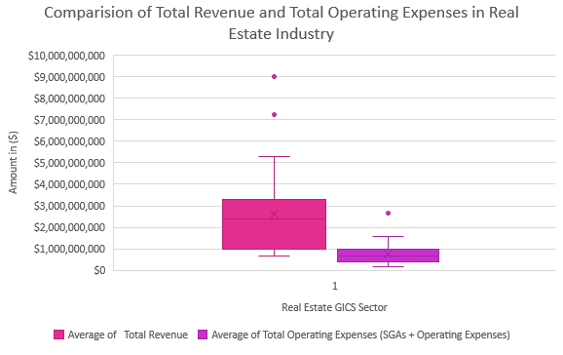
How Can the Spread in Average Total Revenue and Operating Expenses Uncover the Financial Diversity Among Real Estate Companies?
The broad range from $650,012,667 to $9,030,174,000 in Average Total Revenue highlights significant diversity in real estate companies' financial performance, with outliers suggesting potential high performers.
Central tendencies, including a median of $2,356,218,833 and mean of $2,626,694,346, provide insights into the typical revenue range, while the Interquartile Range (IQR) of $2,355,147,667 demonstrates the dispersion around the median.
Operating Expenses range from $186,397,667 to $2,671,000,000, indicating varying financial management efficiency. A $2,671,000,000 outlier suggests a company with exceptionally high expenses.
The IQR of $616,520,416.7 in Operating Expenses highlights the range within which most companies' spending falls, and the standard deviation of $540,456,117.7 offers insights into overall expense variability.
Comparative analysis shows a wider spread in Average Total Revenue than Operating Expenses, indicating diverse revenue streams but consistent expense management in the industry.
The box plots suggest some companies excel in revenue generation without proportionately high operating expenses, revealing potential efficiency in cost management for high-revenue firms.
Inclusion of standard deviation and variation metrics enriches the analysis, providing deeper insights into financial metric dispersion within the real estate sector and identifying potential areas for strategic focus.

Slide 7

Conclusion
My exploration into the financial intricacies of the real estate industry has yielded profound insights. The distribution of total revenue reveals a diverse landscape, with outliers signaling industry leaders. Examining total operating expenses exposes a pattern of cost efficiency, with outliers highlighting strategic spenders. The interplay of revenue and expenses, showcased in the box plots, illuminates a spectrum of financial strategies. Understanding these dynamics is pivotal for strategic decision-making and market anticipation. As stakeholders navigate the nuanced landscape, these revelations serve as a compass, guiding them through the ever-evolving terrain of real estate finance. This journey not only provides a snapshot of the industry's current state but equips us with valuable insights to chart a course for future success.

Slide 8
Appendices

Slide 9
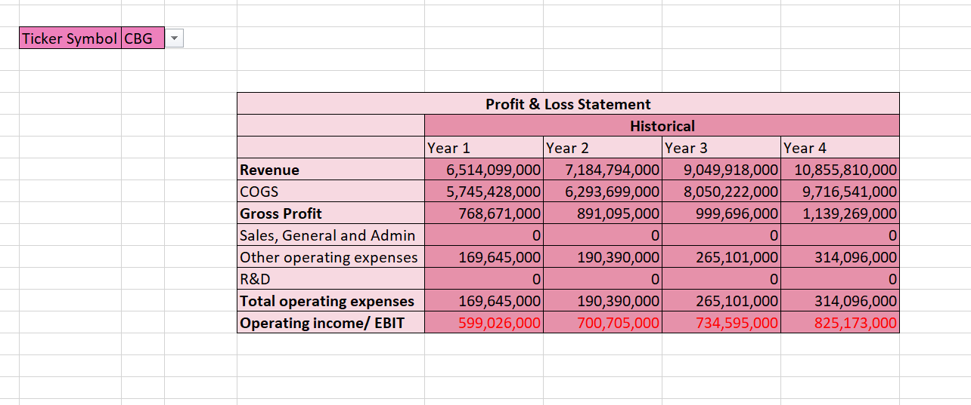
Profit and Loss Statement:

Slide 10
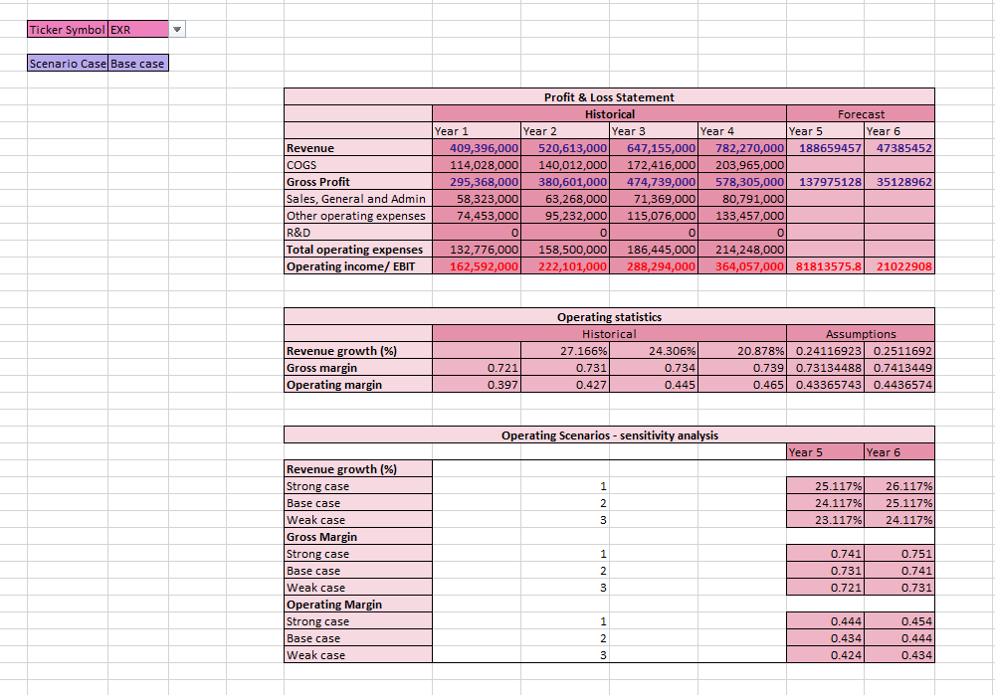
Financial Forecasting Model (Base Case Scenario)

Slide 11

Financial Forecasting Model (Strong Case Scenario)

Slide 12

Financial Forecasting Model (Weak Case Scenario)

